Slide 1


Slide 2


Mohammad Kamali, PhD, PT
Associate Professor,
School of Rehabilitation Sciences
Rehabilitation Research Center
Iran University of Medical Sciences
دکتر محمد کمالی
دانشیار دانشکده علوم توانبخشی
دانشگاه علوم پزشکی ایران
www.mkamali.com
Kamali@mkamali.com
P.O. Box 17445-183

Slide 3
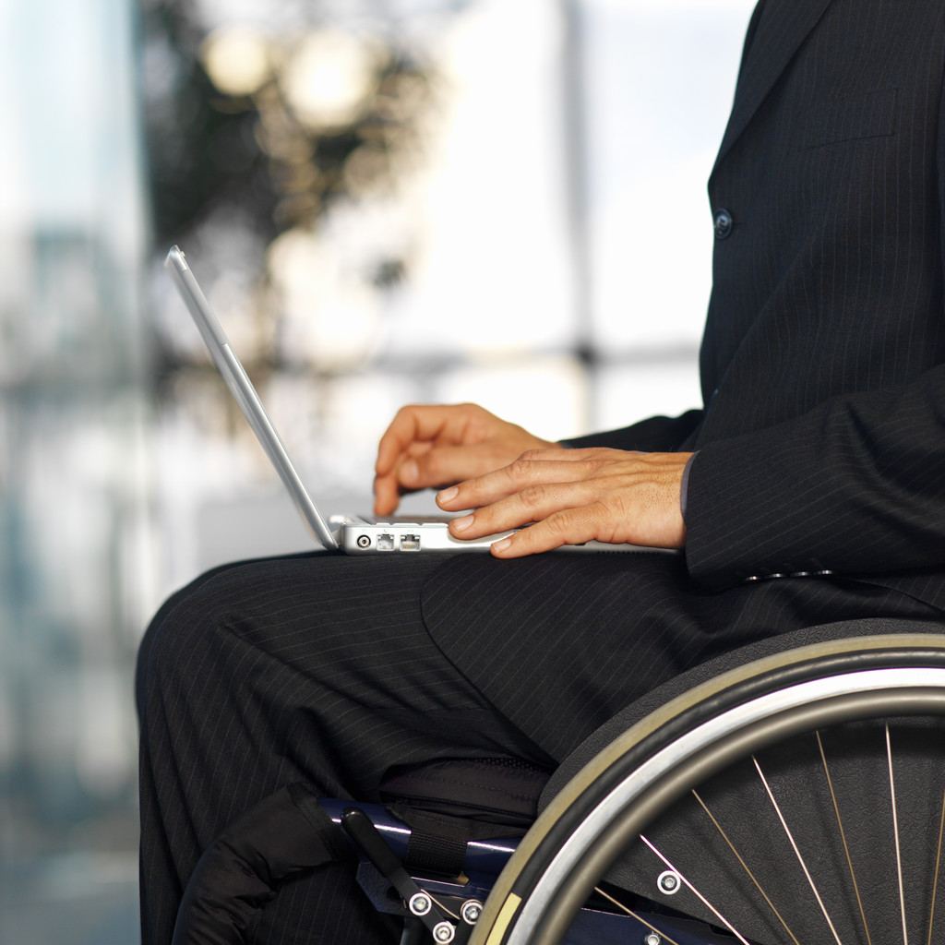
اگر اعضاي يك گروه راهمچون يك گروه نوازنده سامان دهيد قادر خواهيدبوديك سمفوني بنوازيد
ناتوانی، تعریف، مدل ها، آمار

Slide 4
Background
Over 1 billion people with disabilities
3 out of 4 live in developing countries
1 in 5 of the world’s poorest
1 - 2% of children with disabilities receive an education

Slide 5
Background
In developing countries 2% of people with disabilities receive rehabilitation
Women with disabilities are 2 - 3 times more likely to be victims of physical and sexual abuse than women with out disabilities

Slide 6
Background
People who have a disability are viewed as a minority group; however, they are the largest minority group in the world, two-thirds of whom live in developing countries.
There are various ways of understanding of disability. Our understanding of disability influences the way we behave towards them and the way in which structure our educational institutions.

Slide 7
روند تاريخي
نابود سازی/ محو و کشتن
بقا / پناهگاه و نوانخانه
اصلاح عملکرد/ مؤسسه و مراكزويژه
تداخل اجتماعی/توانبخشي مبتني برجامعه
خود شکوفایی/ رهبري

Slide 8
تعاريف معلوليت قبل از 1980
ناتوان در اداره خود و وظايف خانوادگي
ناتوان در مراقبت از خود
ناتوان در كسب حرفه و انجام فعاليت هاي اجتماعي
داراي مشكل در فعاليت هاي روزمره زندگي

Slide 9
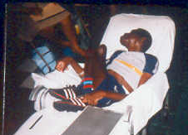
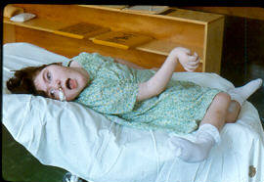
TRADITIONAL PERSPECTIVES
Labeling the person as Incapable of Change, e.g.
Too sick
Too retarded
Too crazy
Too worthless

Slide 10
Definitions of Disability
A disability (or lack of a given ability, as the "dis" qualifier denotes) in humans may be physical, cognitive, sensory, emotional, developmental or some combination of these.
http://en.wikipedia.org/wiki/Disability

Slide 11
Models of Disability
Moral Model
Personal Tragedy Model
Medical Model
Social Model

Slide 12
Moral Model
Two Parts
  Religious and Spiritual origin
    Punishment from God
    Evil spirits
    Witchcraft
    Bad Karma (did something evil in the past)
    Gift from God
  Character weakness
      Corruptness
      Immoral-ness
Notes:
دو قسمت
منشاء دینی و معنوی
مجازات از خدا (به عنوان مثال: با توجه به نارضایتی)
ارواح شیطانی (صاحب)
سحر
بد امتیاز (انجام بد چیزی در گذشته)
هدیه ای از خدا (عبور به خرس، فرشته)
ضعف شخصیت
بودن فاسد
غیر اخلاقی بودن
مثال: خائنانی در فیلم، مادران یخچال و فریزر، تقلید می کنی، انگیزه

Slide 13
Personal Tragedy Model
Disability is considered a tragedy
Society needs to take care and protect persons with disabilities
If someone with a disability achieves something that a “normal” person does, then the person with a disability is looked at as inspirational (super crip)
This is often mixed with the Moral and Medical Models

Slide 14
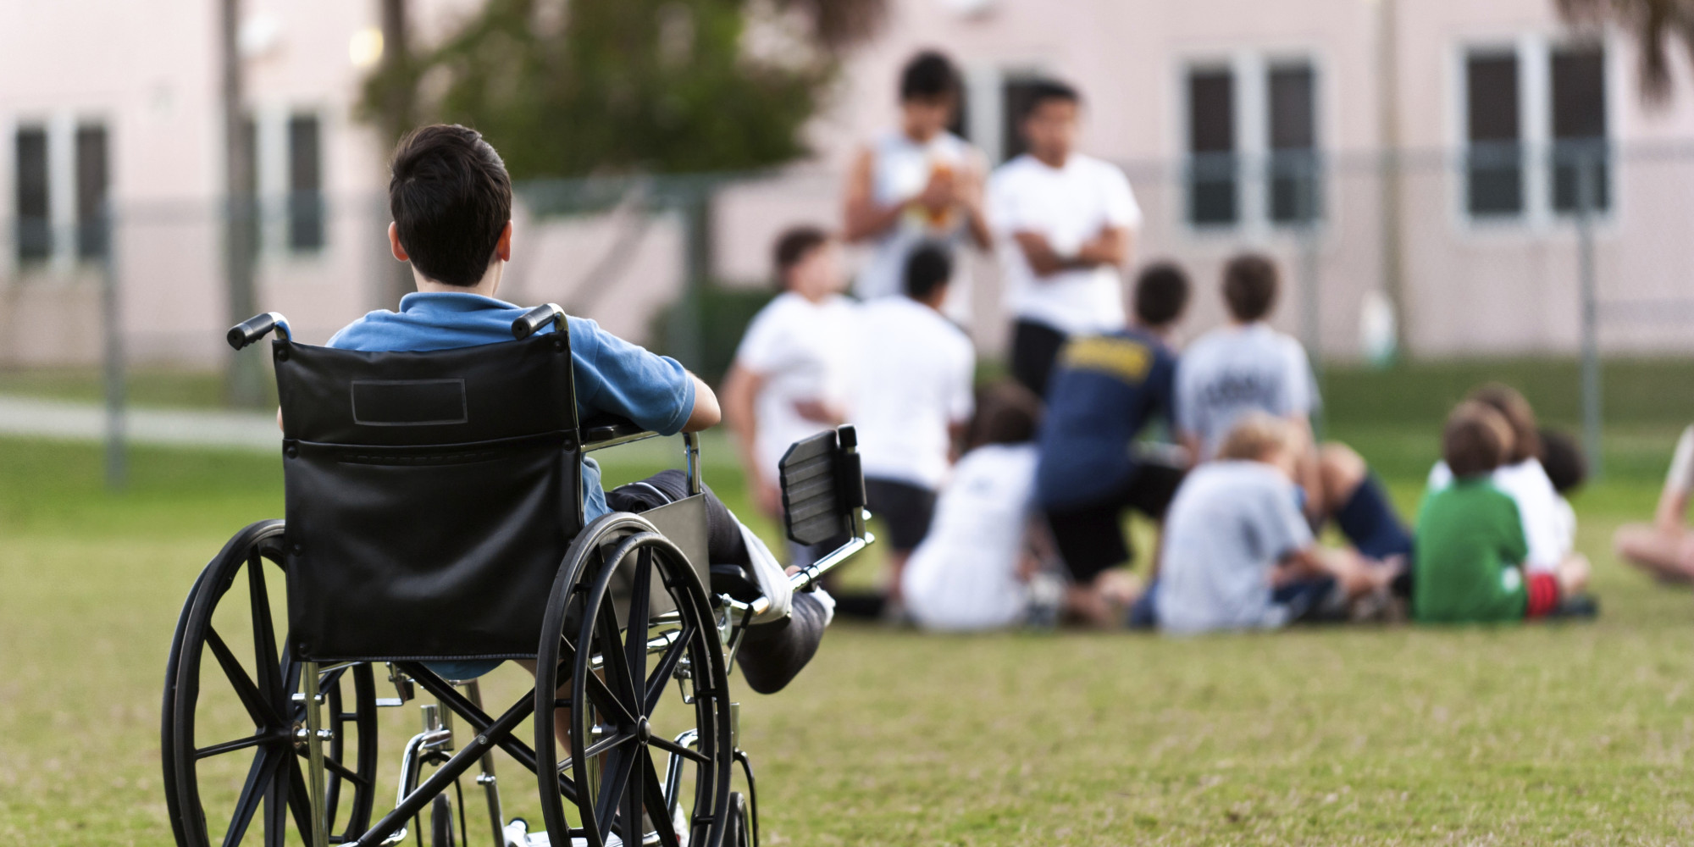

Slide 15
Medical Model 1900s
An individual with a disability has a physical or mental impairment
The disability is within a person
Focus is on minimizing or eliminating the impairment
It can only be fixed in special places
It needs to go to one of those special places to be fixed
It can only come back when it is fixed
Bodies and minds to be fixed/cured
Roots: professionalism
Problem: individual and lack of function/ways we are not viewed as ‘normal’
Solution: rehabilitation, drugs, therapy by professionals who ‘know what’s best’

Slide 16
Medical Model
The ‘Medical Model’ for many years has been the dominant approach to disability.
This model locates the "problem" of disability in the deviant body of the individual, rather than in society itself or in the way the deviant mind or body is perceived.
This model has been strongly criticized for promoting the view that individual impairments determine disability and handicap, rather than attempting to explain the way in which society "disables" people.
It leads us to forget the significance of the social context in which we all live.

Slide 17
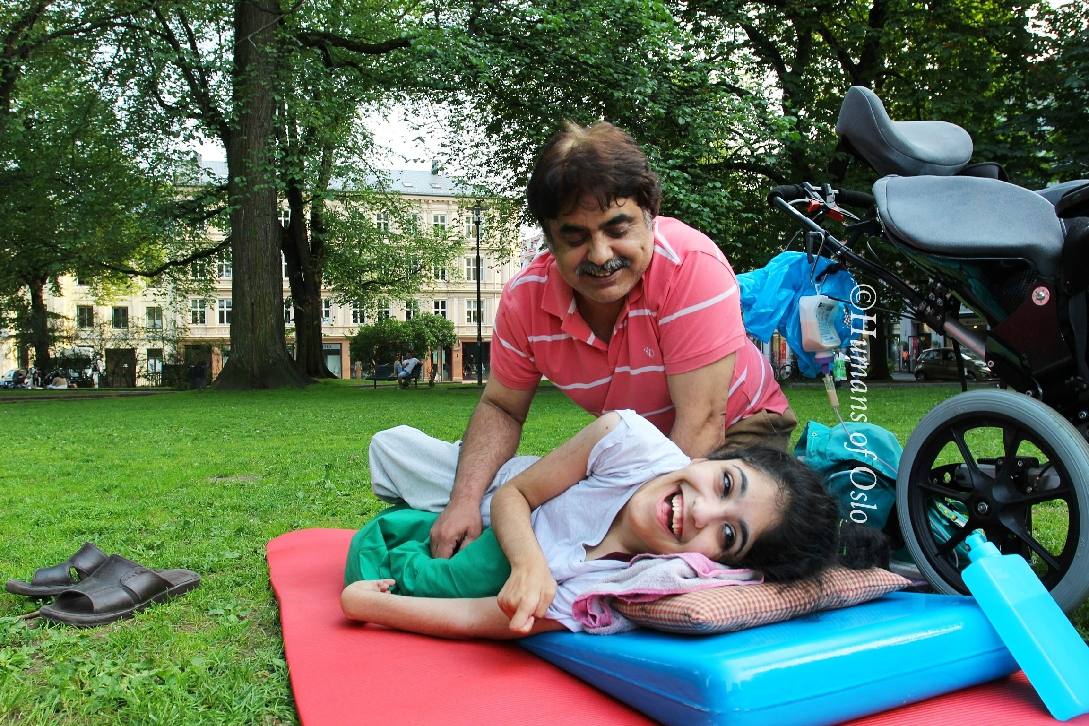

Slide 18
ICIDH(1980)
Three levels of experience of disability:
(Disease or disorder)
impairment disabilities handicaps

Slide 19
ICIDH(1980)
It is based on the World Health Organization's (WHO's) original classification system:
  Impairment: any loss or abnormality of psychological, physiological or anatomical structure or function.
  Disability: any restriction or lack (resulting from an impairment) of ability to perform an activity in the manner or within the range considered normal for a human being.
  Handicap: a disadvantage for a given individual, resulting from an impairment or disability, that limits or prevents the fulfillment of a role that is normal (depending on age, sex and social and cultural factors) for that individual.

Slide 20
Definitions of Disability
The International Classification of Impairments, Disabilities and handicaps in 1980:
Disability is defined as any reduction or lack (resulting from an impairment) in the ability to perform activities in a manner which is normal, while handicap describes the social disadvantage resulting from an impairment or disability.

Slide 21
Social Model
Instead of disability originates within the person, disability originates from society
Disability results from barriers in society and the environment
  Physical barriers
  Attitudinal barriers

Slide 22
Social Model
The ‘Social Model’ sees disability as a result of environmental and social factors: people with impairments are disabled by barriers in society, by its structures and norms.
Disability is the disadvantage or restriction caused by a contemporary social organization which takes no or little account of people who have impairments and thus excludes them from the mainstream of social activities.

Slide 23
Social Model
Definitions of disability reflect society’s view of disability and of people with impairments.
By this definition disability is external to the individual, and is a result of environmental and social factors: disabled people are people with impairments who are disabled by barriers in society.

Slide 24
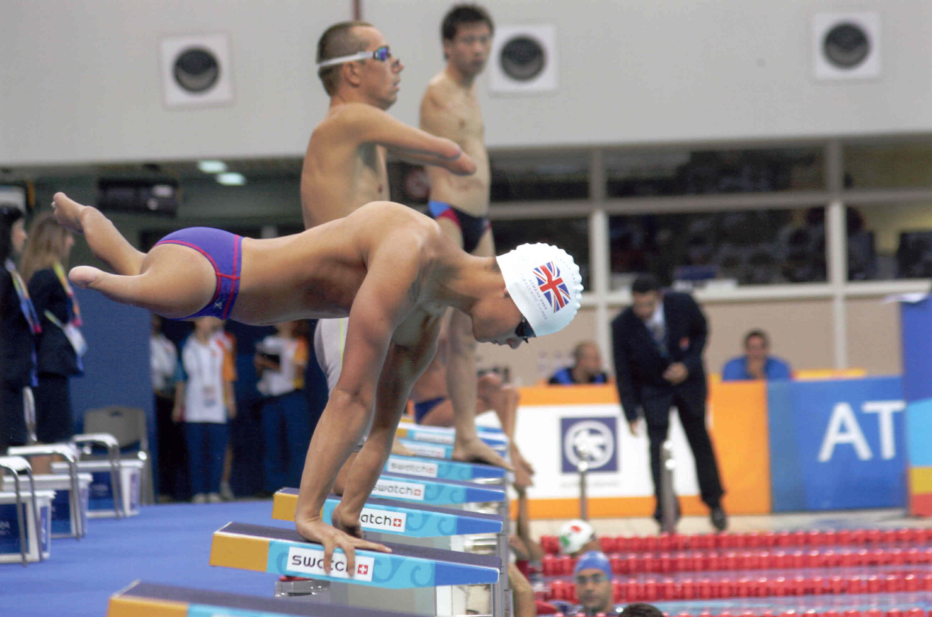

Slide 25
طبقه بندي اختلال ، ناتواني ، معلوليت
نگرش مثبت
اختلال (Impairment)
فعاليت (Activity)
مشاركت (Participation)
نگرش منفي
اختلال (Impairment)
ناتواني (Disability)
معلوليت (Handicapped)
ICIDH-2
ICIDH

Slide 26
Definitions of Disability
Disabled people’s International Classification of impairment and Disability
  An impairment is the loss or abnormality plus the effect on function.
  A Disability is the disadvantage or restriction of activity caused by social factors which take little or no account of people who have impairments and thus exclude them from the mainstream of social activities. (DPI, 1990)

Slide 27
ICF(2001)
According to International Classification of Functioning, Disability and Health(2001), restriction of participation in activities is central to disability, placing emphasis on impact rather than cause.
Disability can therefore occur to a greater or lesser extent, depending on the fluctuating nature of certain factors.

Slide 28
International Classification of Functioning, Disability and Health (ICF. WHO, 2001)
Health condition (disorder, disease)
Body Functions and Structures
(Impairments)
Activities
(Limitations)
Participation
(Restrictions)
Environmental
Factors
Personal
Factors

Slide 29
Definitions of Disability
Disability, according to the World Health Organization, is defined as "...an umbrella term, covering impairments, activity limitations, and participation restrictions.
An impairment is a problem in body function or structure;
An activity limitation is a difficulty encountered by an individual in executing a task or action; while a participation restriction is a problem experienced by an individual in involvement in life situations.
Thus disability is a complex phenomenon, reflecting an interaction between features of a person’s body and features of the society in which he or she lives.”
    http://www.who.int/topics/disabilities/en/

Slide 30
Body functions
& structures
Activity
& Participation

Slide 31
Activity is the execution of a task or action by an individual. It represents the individual perspective of functioning.

Slide 32
Activity is the execution of a task or action by an individual. It represents the individual perspective of functioning.
Participation is involvement in a life situation. It represents the societal perspective of functioning.

Slide 33
Impaired
body functions
& structures
Limitation in activity
Restriction in participation

Slide 34
Disability
Health Condition
(disease, disorder)
Impairment of body function & structure
Limitation
in activities
Restriction
in participation
Environmental
Personal
Factors
Factors
Contextual factors

Slide 35
Disability

Slide 36
Functioning

Slide 37
Concepts of Disability
Social model vs. medical model
Disabling environment or personal deficit
“Disability is not something individuals have. What individuals have are impairments”
  New Zealand Disability Strategy (2001)

Slide 38
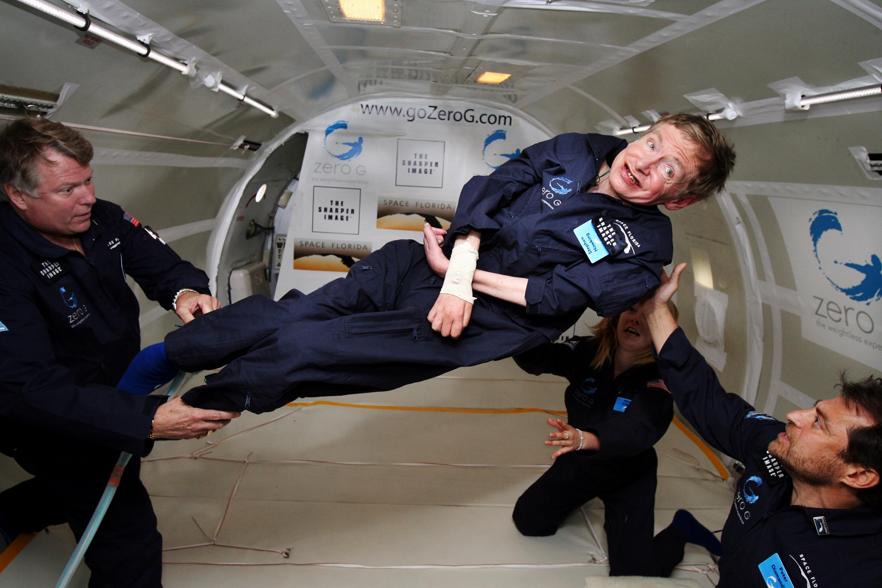

Slide 39
Social Model
The social model takes account of disabled people as part of our economic, environmental and cultural society.
The barriers that prevent any individual playing a part in society are the problem, not the individual.
Barriers still exist in education, information and communication systems, working environments, health and social support services, transport, housing, public buildings and amenities.
The devaluing of disabled people through negative images in the media – films, television and newspapers – also act as a barrier.
The social model has been developed with the aim of removing barriers so that disabled people have the same opportunity as everyone else to determine their own life styles.
Notes:
http://www.open.ac.uk/inclusiveteaching/pages/understanding-and-awareness/social-model.php

Slide 40
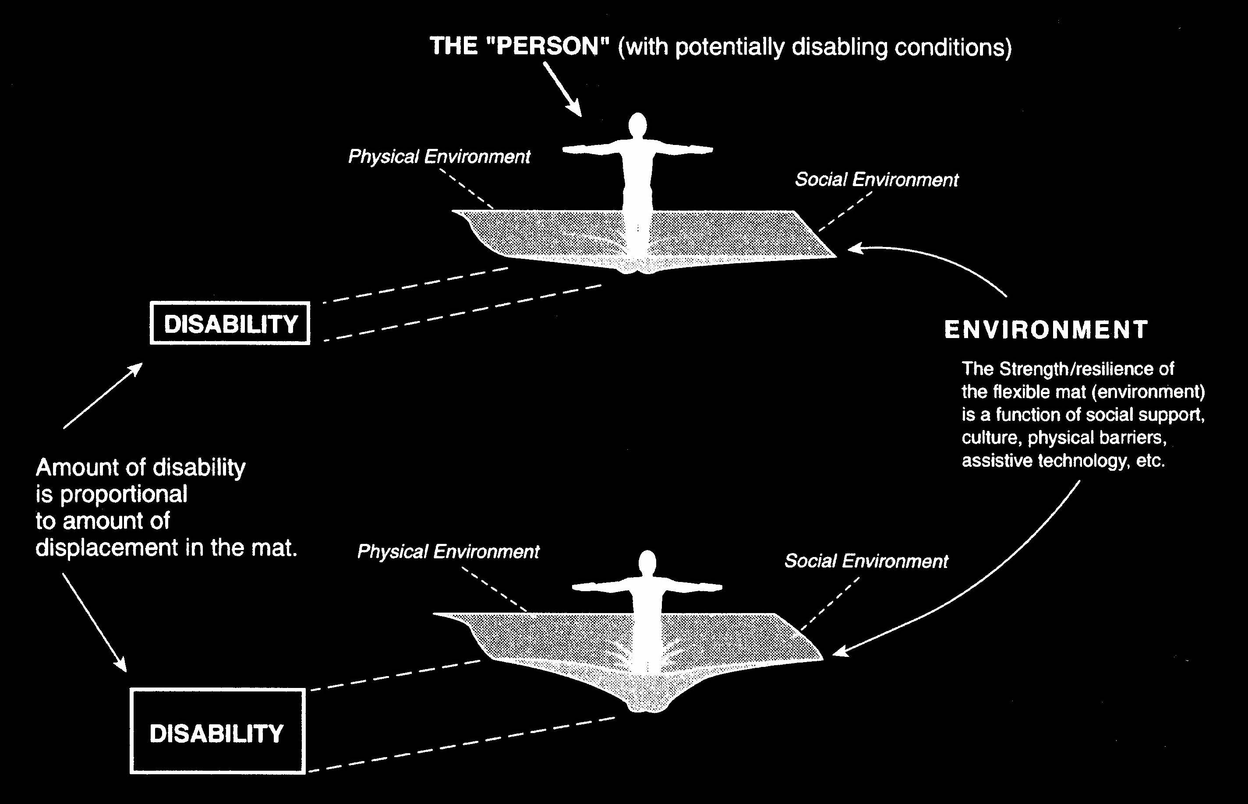
Disability is a function of the interaction between the person and the environment

Slide 41
Concepts of Disability
“We must create a world in which disability is: ”
  understood & accepted as a normal part of the human experience
  not a lifelong experience of loss & sadness
  life that is interesting, exciting, challenging ,joyous
  in a society that is inclusive
  able to avoid unnecessary & unwanted economic dependence
  (NIDRR, 1993)

Slide 42
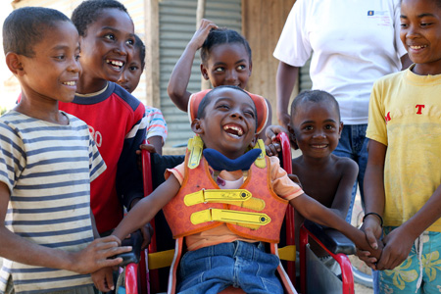

Slide 43
Current paradigm of disability...
Assumes that the person with a disability is healthy…”that is a disabling condition does not imply illness and disease.”
(Brandt, p104)

Slide 44
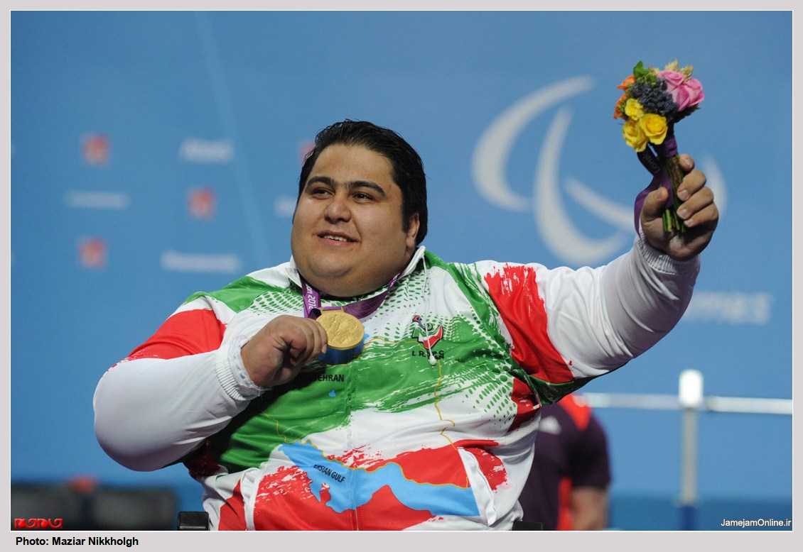
سیامند رحمان قویترین مرد معلول جهان و قهرمان فوق سنگین وزنه برداری جهان و بازی های پارالمپیک

Slide 45
person with disability
In accordance with the United Nations terminology and concepts on Equal Opportunities for people with disabilities, and in accordance with the international categorisation of the World Health Organisation (WHO) 2001, the term ‘handicapped person’ is replaced by the term ‘person with disability’ (individually) and ‘people with disabilities’ (at the society level).

Slide 46
person with disability
A disabled person is the one who in his or her society is regarded or officially recognized as such, because of a difference in appearance and/or behavior, in combination with a functional limitation or an activity restriction.

Slide 47
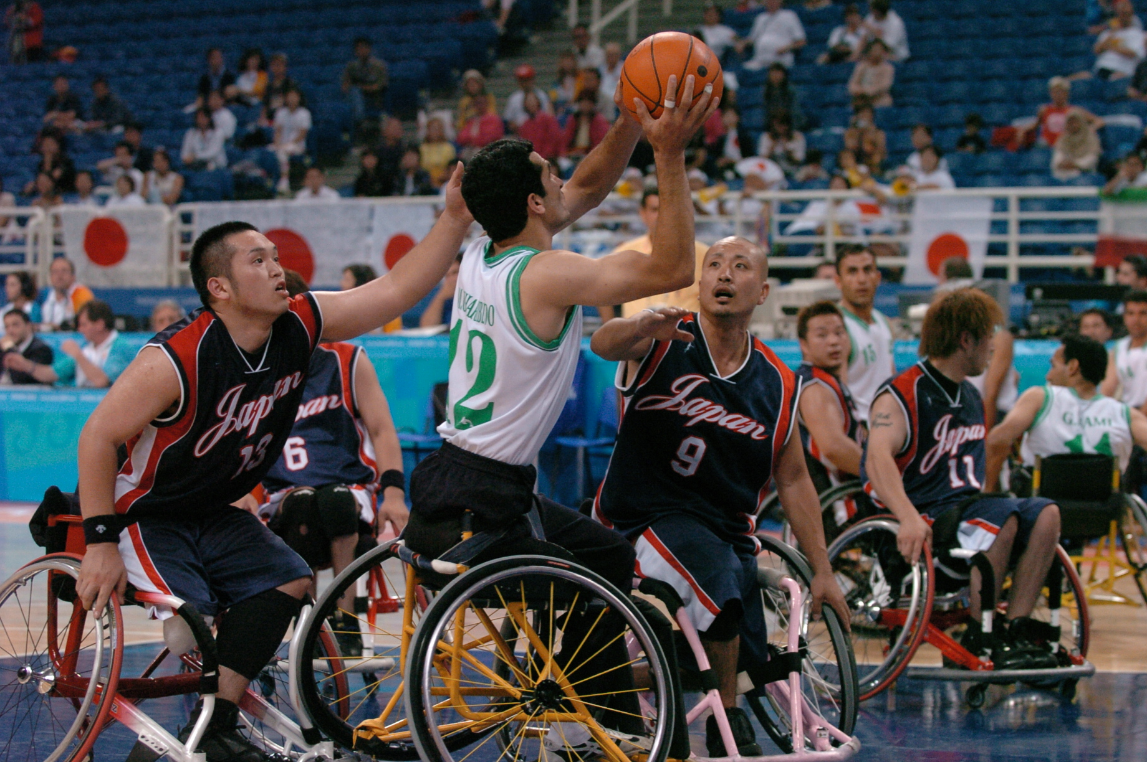

Slide 48
آمارهای جهانی از ناتوانی و معلولیت
تا سال 2010 سازمان ملل متحد و سازمان جهانی بهداشت حدود 10 درصد از جمعیت جوامع را دارای نوعی از ناتوانی و معلولیت محسوب می کردند.
این بیان در سال 2011 در پیام دبیرکل سازمان ملل متحد به مناسبت روز جهانی معلولان به 15 درصد و بیش از یک میلیارد نفر افزایش یافت.

Slide 49
آمارهای جهانی از ناتوانی و معلولیت
پیمایش جهانی سلامت (World Health Survey) در فاصله سال های 2002-2004 بوده است. چارچوب مفهومی و قلمروهای عملکردی این پیمایش از ICF گرفته شوده بود. داده های 70 کشور که از میان آنها 59 کشورکه حدود 64% جمعیت جهان را در بر داشتند، برای تخمین میزان شیوع ناتوانی در بین جمعیت بالای 18 سال وزن دهی شدند.
برای این 59 کشور در پیمایش، میانگین میزان شیوع ناتوانی در جمعیت بزرگسال بالای 18 سال حدود 15.6% بود.

Slide 50
آمارهای جهانی از ناتوانی و معلولیت
مطالعه بار جهانی بیماری(Global Burden of Disease study) نوع دیگری از تخمین برای میزان شیوع ناتوانی را در بر داشته است.
تجزیه و تحلیل داده های بروز شده مطالعه بار جهانی بیماری در سال 2004 تخمین زد که 15.3% از جمعیت جهان(حدود 978 میلیون نفر از جمعیت تخمینی 6.4 میلیارد نفری در سال 2004) ناتوانی متوسط یا شدید داشته اند، در حالی که 2.9% یا حدود 185 میلیون نفر ناتوانی شدید را تجربه کرده اند

Slide 51
آمارهای ناتوانی و معلولیت در ایران
در سرشماری سال 1365 برای نخستین بار طرح سوالی پیرامون معلولیت صورت گرفته است.
در این سال موارد مطلق معلولیت مدنظر قرار گرفته و واحد اندازه گیری بر اساس فرد دارای معلولیت بوده است.
واژه های به کارگرفته شده برای مشخص کردن ناتوانی و معلولیت عبارت از: نابینا، کرولال، کر، قطع دست یا پا یا هر دو، نقص دست راست، نقص دست چپ، نقص پای راست، نقص پای چپ و فلج کامل بوده اند.
افراد شمارش شده در مجموع 526020 نفر بوده اند که با توجه به جمعیت کلی شمارش شده به میزان 49445010 نفر می توان گفت میزان شیوع معلولیت بر اساس این سرشماری 1.06 درصد بوده است.
بیشترین میزان معلولیت را افراد دارای ناتوانی جسمی با حدود338484 نفر داشته اند و نابینایان 96877 نفر و ناشنوایان نیز 80443 نفر بوده اند. نکته قابل ذکر اینکه در این سرشماری از کم توانی ذهنی پرسش به عمل نیامده است.

Slide 52
آمارهای ناتوانی و معلولیت در ایران
در سرشماری سال 1375 واحد اندازه گیری به خانوار تغییر می یابد.
در اين‌ سرشماري‌ وجود فرد يا افراد معلول در مورد معلوليت ها در خانوار مورد پرسش‌ قرارگرفته ‌است‌. بنابراين‌ در صورتي كه ‌حداقل ‌يكي‌ از اعضاي‌ خانوار، يكي‌ از معلوليت هاي‌ نابينائي‌، ناشنوايي، جسمي‌ ـ حركتي‌ و عقب‌ماندگي‌ ذهني‌ را داشته‌ باشد، خانوار داراي‌ معلول‌ محسوب‌ شده ‌است‌.
از این رو از مجموع 12387943 خانوار شمارش شده بر این اساس، حدود 3/87 درصد از خانوارهای کشور (479590 خانوار) اعلام نمودند در خانواده خود دارای فردی با معلولیت و ناتوانی هستند.
از این تعداد خانوارهای دارای فرد نابینا 78174، ناشنوا 71858، معولیت جسمی 210645 و عقب ماندگی ذهنی 146921 خانوار اعلام شده است.

Slide 53
آمارهای ناتوانی و معلولیت در ایران
در سرشماری سال 1385 بار دیگر واحد اندازه گیری به فرد دارای ناتوانی و معلولیت تغییر پیدا می کند و از سوی دیگر در مورد معلولیت های ذهنی هم جامعه مورد پرسش قرار می گیرد.
در این سال شاهد تغییر گسترده ای در ارقام سرشماری هستیم. جمعیت کل کشور در این سال به رقم 70495782 نفر بالغ می گردد. علاوه بر اینکه از ناشنوایی به طور مطلق سوال می شود از اختلال های گفتار و صدا نیز پرسش به عمل می آید که مجموع اختلال های شنیداری را به رقم 244251 نفر می رساند. نابینایان با تغییرکمی همچون سرشماری های گذشته بالغ بر94231 نفر می باشند. تعداد افراد با معلولیت جسمی به 623672 نفر افزایش می یابد و پرسش از اختلال ذهنی تعداد 295218 نفر را شامل می سازد.
بر این اساس جمعیت افراد دارای ناتوانی و معلولیت حدود 101222 نفر به دست می آید. در نتیجه می توان گفت میزان شیوع ناتوانی و معلولیت در سرشماری 1385 بالغ بر 1.43 درصد بوده است.

Slide 54
آمارهای ناتوانی و معلولیت در ایران
بر اساس سرشماری نفوس و مسکن سال1390 بار دیگر شاهد تغییر واحد اندازه گیری به خانوار هستیم.
از 21185647 خانوار کشور، 919163 خانوار اعلام نموده اند که دارای عضو با معلولیت بوده اند.
بنابراین آمار، نسبت خانوارهای دارای عضو دارای معلولیت به کل خانوارهای کشور، برابر 4.3 درصد است.
به عبارت دیگر در بین هر 100 خانوار ساکن ایران، حدود 5 خانوار دارای عضو دارای معلولیت وجود داشته است.

Slide 55
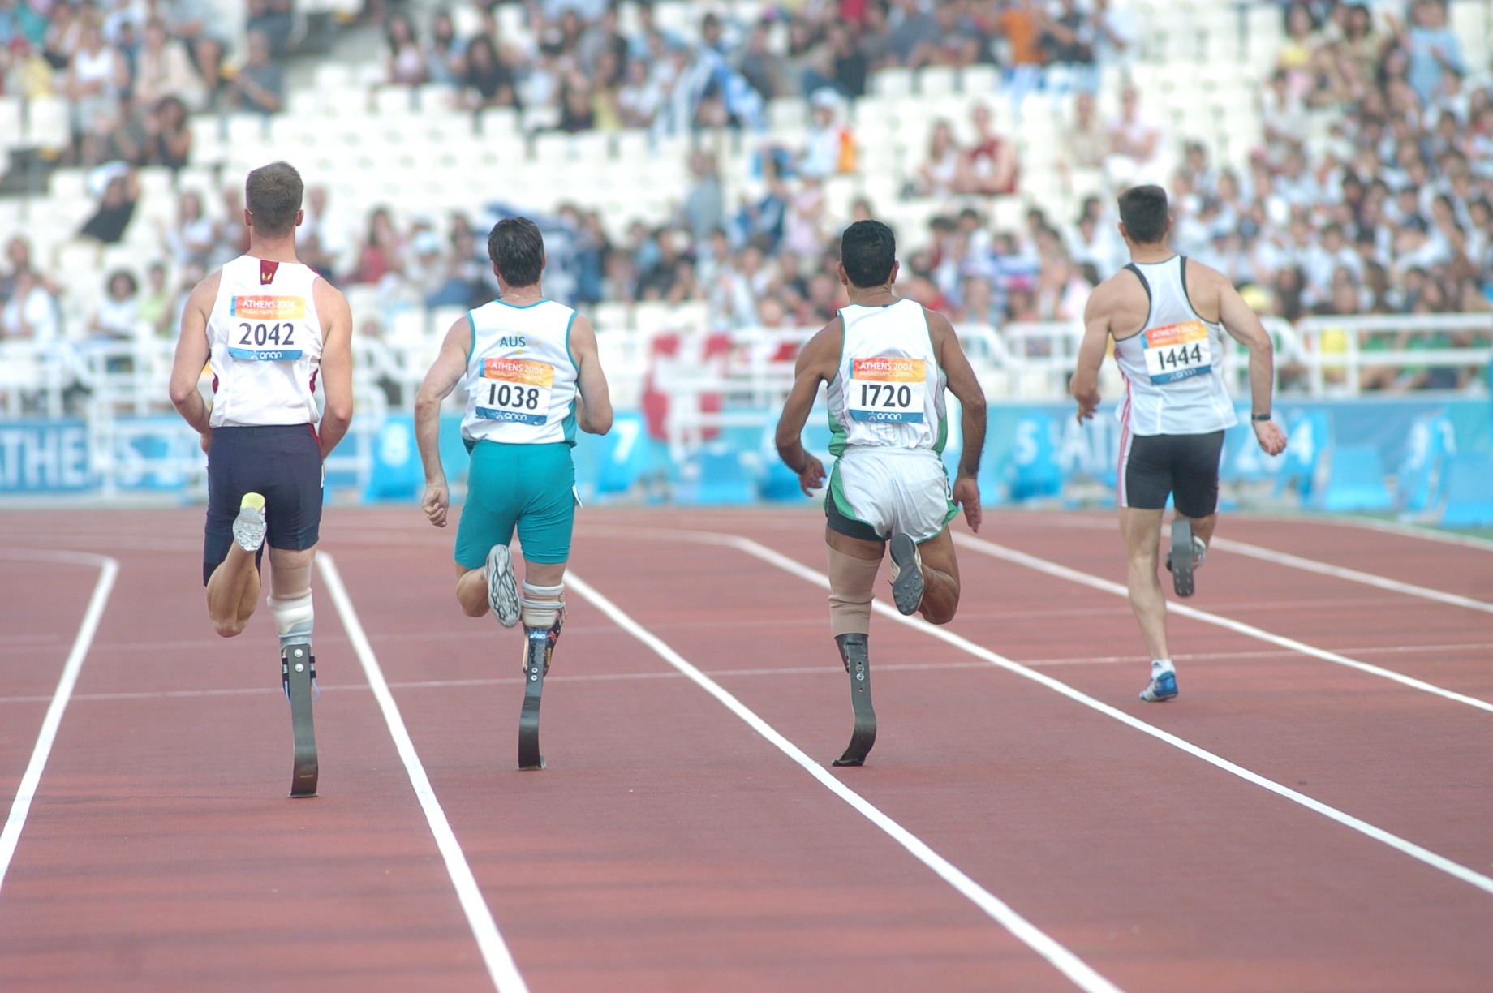

Slide 56

Disability and disasters
A few Facts
Every Year, approximately 20 million people with disability are affected by disasters
15 % of any population has some form of disabilities (WHO)
15 to 20 % of the world poorest people have a disability (World Bank)

Slide 57
Disability and disasters
Natural and man-made disasters tend to have a dispropotionate impact on people with disabilities. This issue is recognised and addressed by Article 11 of the United Nations Convention on the Rights of Persons with Disabilities which states:
States Parties shall take, in accordance with their obligations under international law, including international humanitarian law and international human rights law, all necessary measures to ensure the protection and safety of persons with disabilities in situations of risk, including situations of armed conflict, humanitarian emergencies and the occurrence of natural disasters."[1]

Slide 58
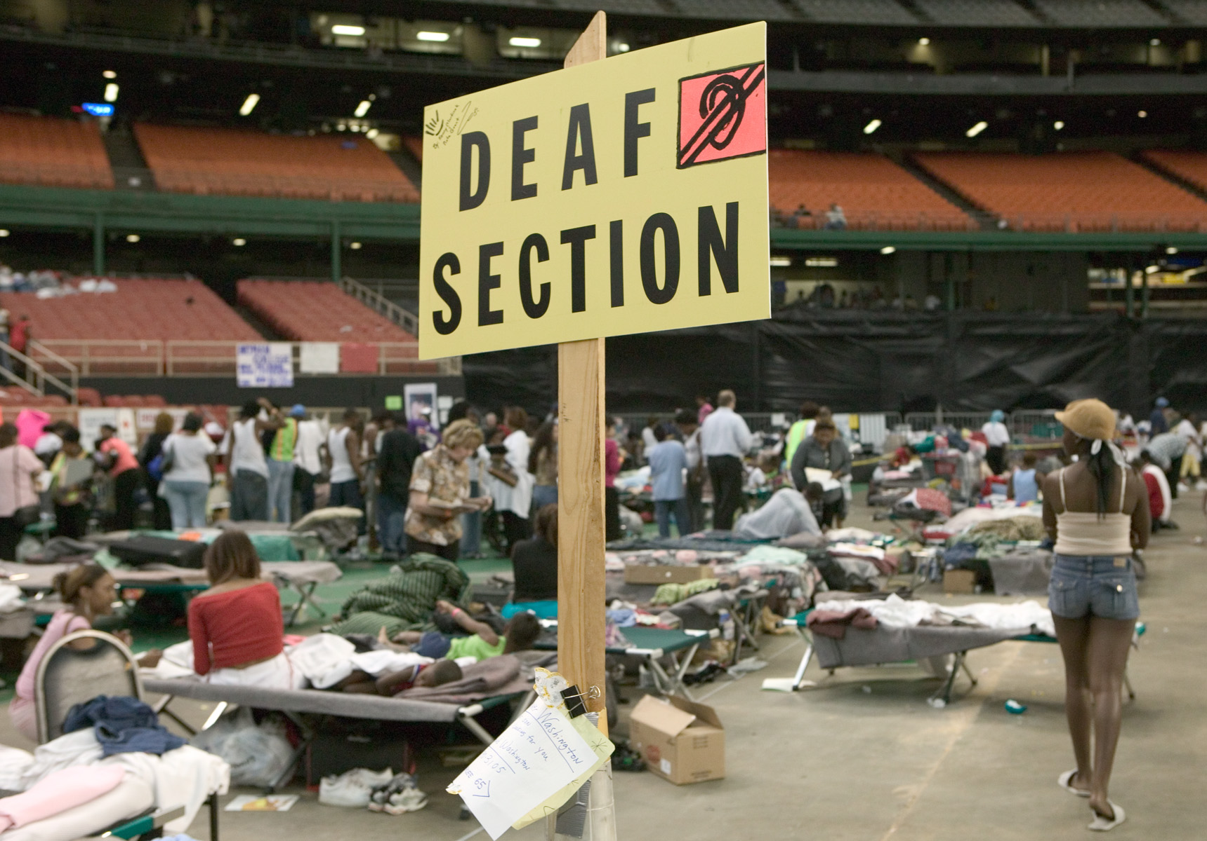
Deaf section for Hurricane Katrina evacuees at the Houston Astrodome. (Houston, TX., 9/10/2005 -- FEMA photo/Andrea Booher)

Slide 59
People with disabilities in the aftermath of disasters
Persons with severe injuries
When disaster strikes people will experience physical and psychological traumas. In line with first medical attention, specific attention to prevent secondary complication and disability and ensure appropriate rehabilitation, follow-up and referral
Persons with impairment leading to disability
When victims have acquired impairment as a consequence of disaster, ensuring that people access to early rehabilitation services to facilitate recovery and to minimize disabilities as well as long term planning of services to ensure follow-up and comprehensive rehabilitation process
Persons with previous disability
Persons with disabilities are part of any society, (This includes persons with chronic diseases such as diabetes; epilepsy that unattended could lead on a long-term period of disability). Ensure their visibility and their access to all relief activities with the objective to prevent worsening of disabilities and their participation and equal opportunities for them and their familie

Slide 60
Specific vulnerabilities
Disabled people tend to be invisible in emergency registration system
Lack of awareness about disability among humanitarian organizations
Disabled people are more affected by changes in environment resulting from disasters
Inadequate physical Accessibility, loss or lack of mobility aids or appropriate assistance deprive them from rescue, evacuation, access to relief, safe location, adequate shelters…
Emotional distress and trauma have more long term consequences
Communication difficulties

Slide 61
Research
There is limited research knowledge, but many anecdotal reports, on what happens when disasters impact people with disabilities.^{[2][3]} Individuals with disabilities may be greatly affected by natural disasters.^{[2][4]} Those with physical disabilities can be at risk when evacuating if assistance is not available. Individuals with cognitive impairments may struggle with understanding instructions that must be followed in the event a disaster occurs.^{[5][6][4]} Those who are blind, hearing impaired, etc. may have difficulty communicating during the emergency. All of these factors can increase the degree of variation of risk in disaster situations with disabled individuals.^{[7]}

Slide 62
Discrimination
Some research studies have found discrimination against individuals with disabilities during all phases of the disaster cycle.^{[2]} The most common limitation is that people cannot physically access buildings or transport, as well as access disaster-related services.^{[2]} The exclusion of these individuals is caused in part by the lack of disability-related training provided to emergency planners and disaster relief personnel.^{[8]}

Slide 63
Disability in disaster management planning
Disability as a factor in disaster planning is an issue that is receiving attention from some disaster management jurisdictions while various disability rights organizations are active in lobbying and education efforts for authorities to include the needs of disabled members of the public in their planning.^{[9][10][11][12]}

Slide 64
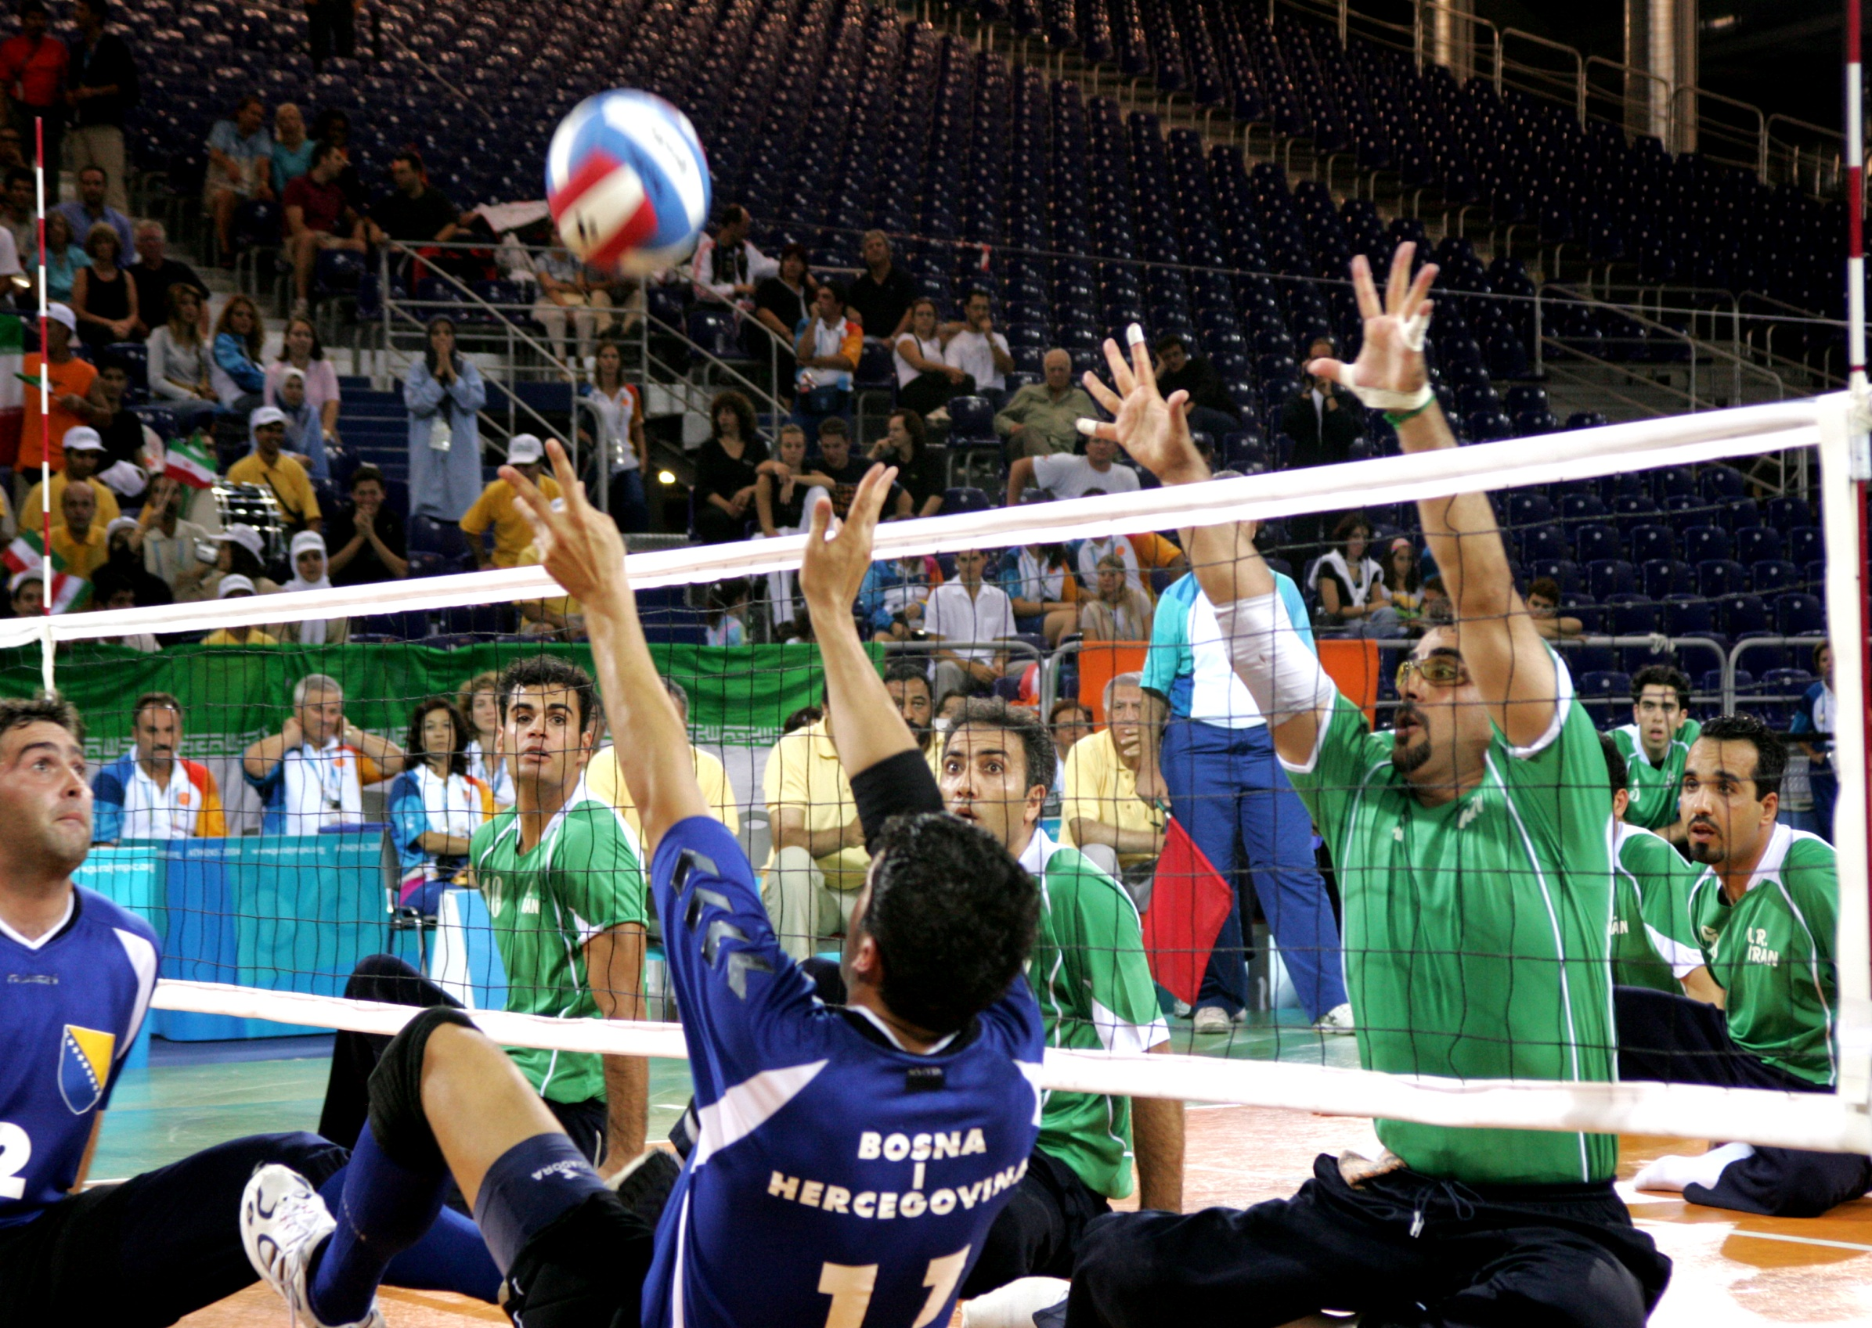

Slide 65
